Slide 1
A New Vision for ATM Security Management
Toulouse, 23 March, 2016

Slide 2

























Consortium Composition
8 Countries
19 partners:
10 Large Industries
3 SMEs
3 Research org. and Universities
3 End-users

Slide 3
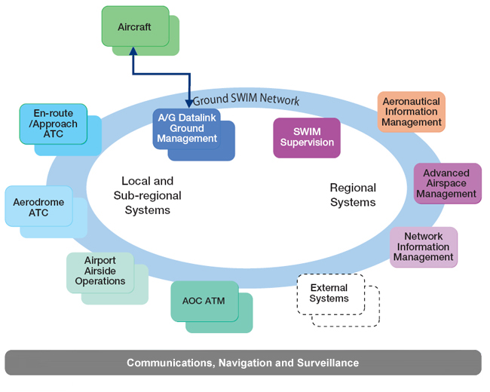


Why GAMMA?
The need for a holistic approach
ATM as a system of system
Domino effects spreading security threats within ATM and beyond
Security Life cycle: from threat prevention to crisis management

Slide 4
GAMMA scope and positioning: an end to end approach
Security Stakeholder
Security Stakeholder
ATM
sub-system
ATM
sub-system
ATM
sub-system
ATM Domain
ATM
sub-system
ATM
sub-system
Security Stakeholder

Slide 5
GAMMA: a Helicopter view
Implementation
Proposals
Validation
Validation Platforms
ATM Security Solution
ATM physical infrastructure Security
ATM CNS Security
ATM Crisis Management
ATM Cyber Security
ATM Security Requirements
ATM Threat Assessment
SESAR
Notes:
5

Slide 6
GAMMA Security Risk Assessment and Treatment

Slide 7
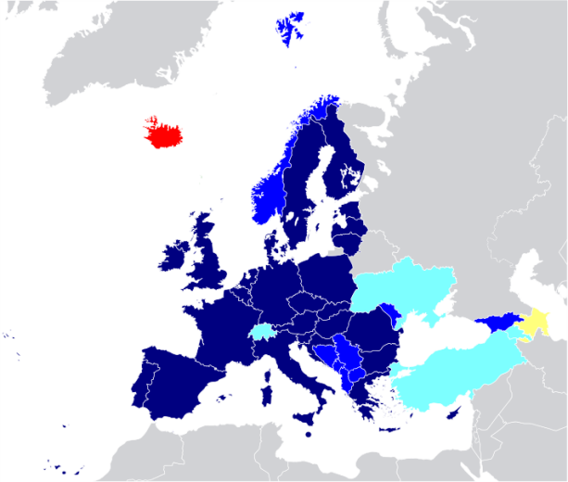
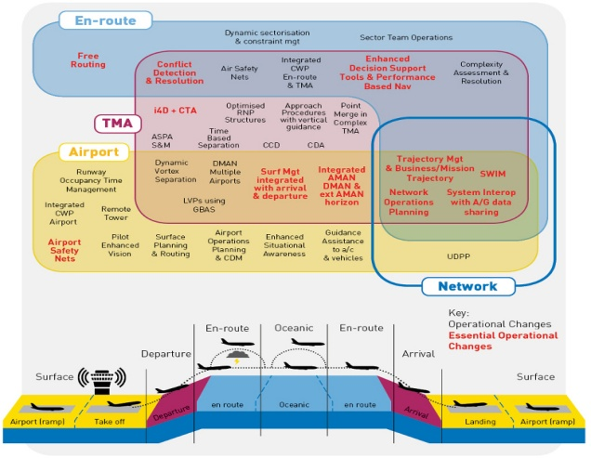


GAMMA ATM threat assessment model: SCOPE
Geographical
Functional
Scenarios
European Common Aviation Area
Air Traffic Managment & SESAR step 1
Most Feared

Slide 8
Achievements
Context establishment, threat analysis and evaluation report
  Definition of context establishment in terms of scope, assets and boundaries of the European ATM.
  The scope of the study: focus on security of European ATM legacy systems + SESAR step1;
  The risk analysis was based on the SecRAM methodology (defined by SESAR) in order to ensure the consistency with SESAR WP 16.06.02;
  The approach is holistic in terms of scope (ATM is considered here as a system of European systems with worldwide interconnections) but focuses on the major primary assets (ATM core functions), their respective supporting asset and the most feared threat scenarios.

Slide 9


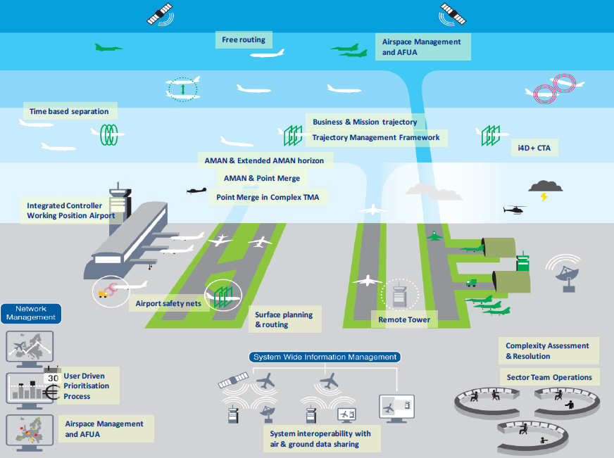
Security Threats in the ATM world
Supporting Assets
Threats
Impacts
Primary asset
ILLUSTRATIVE
CNS Service
RPA
Jamming
Denial of Service
RPA - GS
Wireless Network
Physical Damage
Network
Media Injection
ATM Service
Block
Runway Incursion
Notes:
Bucnado il GPS e dando posizionamenti fasulli, bucando il wireless,

Slide 10
Achievements
Security Risk Assessment and treatment
  Defined the Security objectives; Identified the Risk levels and Security needs
  Identified the security controls to treat the risk in order to meet the security objectives:
    With the help of MSSC from SESAR:
      Used MSSC as is (generic security control);
      Refined MSSC to adapt it to the context;
    Defined additional security controls.
  Identified the residual risk and security recommendations when needed;
  Defined Security indicator KPI to measure the effectiveness of the security controls.
Notes:
Additional = doesn’t cover any MSSC area
Security recommendations : exemple TRT

Slide 11



Security Risk Assessment and Treatment in GAMMA
ATM Core Functions (Primary Assets)
13
SecRAM
Supporting Assets
What
59
Threat Scenarios
(most feared threats)
44
High level Risks
95
Why
Security Controls
318
Security KPIs
How
27

Slide 12
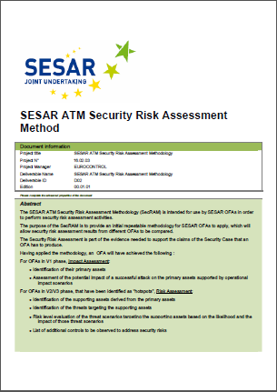
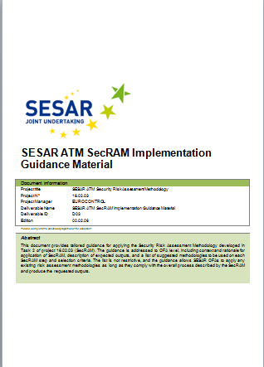
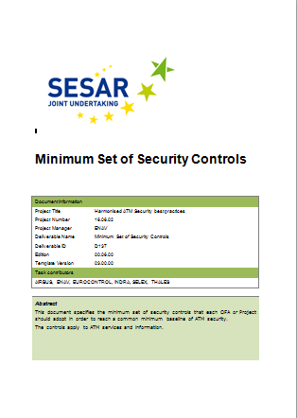
SESAR 1 – GAMMA –SESAR2020
Security Risk Assessment
GAMMA Solution Definition
GAMMA Solution Architecture
SESAR 2020 Architecture:
ATM SECURITY Domain System
ADD SESAR2020 Transition Workshop
B4.3 project

Slide 13

Building the GAMMA Security Risk Assessment from SESAR
Aligned with SESAR (SECRAM) methodology
Building on SESAR Minimum set of Security Controls (MSSC)
Open for future extensions by SESAR 2020 and other Extensions.
Future Extensions
Future Extensions
Security KPI
Future Extensions
Future Extensions
GAMMA Additional Security Controls
SESAR MSSC
SESAR MSSC
SESAR SECRAM
SESAR SECRAM
SESAR SECRAM

Slide 14
GAMMA Concept Of Operations

Slide 15

ATM Security Regulatory Framework: GAMMA main pillars
EC 1035/2011 Annex 1 chapter 4:
  «Air navigation service providers shall establish a security management system to ensure:
    the security of their facilities and personnel so as to prevent unlawful interference with the provision of air navigation services;
    the security of operational data they receive or produce or otherwise employ, so that access to it is restricted only to those authorized.“
  EC Regulation 549/2004 Article 13:
  Security governance is a State matter and Member States have the power to implement appropriate measures to safeguard the public (See Article 4 (2) of Lisbon Treaty).
ICAO Annex 17 chapter 2:
  “Each Contracting State shall establish and implement procedures to share with other Contracting States threat information that applies to the aviation security interests of those States, to the extent practicable.”
ICAO Doc 9985 (ATM Security Manual)
  “the safeguarding of the ATM system from security threats and vulnerabilities, and the contribution of the ATM system to civil aviation security, national security and defence, and law enforcement.”.
GAMMA Solution
Regulatory Framework
  EC Regulation 549/2004 Article 13
ICAO Doc 9985 (ATM Security Manual)
EC 1035/2011 Annex 1 chapter 4
ICAO Annex 17 chapter 2
Notes:
The GAMMA solution can be conceptualised comprising the following conceptual elements:
GAMMA organisation – the establishment of a distributed set of GAMMA operators and users within the operational context jointly collaborating in the management of security;
GAMMA continuous security management capability; which is related to the 24/7 operations of the security management component for the establishment of “security situational awareness”;
GAMMA situation management / incident management capability – the set of functions and capabilities to manage security incidents;
GAMMA distributed network and information exchange – the technical means for the day-to-day dynamic management of system security.

Slide 16
The GAMMA Concept
The operational and technical scope of the GAMMA vision is given by the existing ATM system and its evolution foreseen within SESAR.
The GAMMA solution can be conceptualised as a network of distributed nodes embedded within the ATM system and providing interfaces to (ATM) internal and external security stakeholders.
GAMMA establishes three different levels for managing security:
  the European level represented by the European GAMMA Coordination Centre (EGCC),
  the National level represented by the National GAMMA Security Management Platform (NGSMP)
  the local level represented by local security systems as well as Local GAMMA Security Operation Centres (LGSOC).

Slide 17
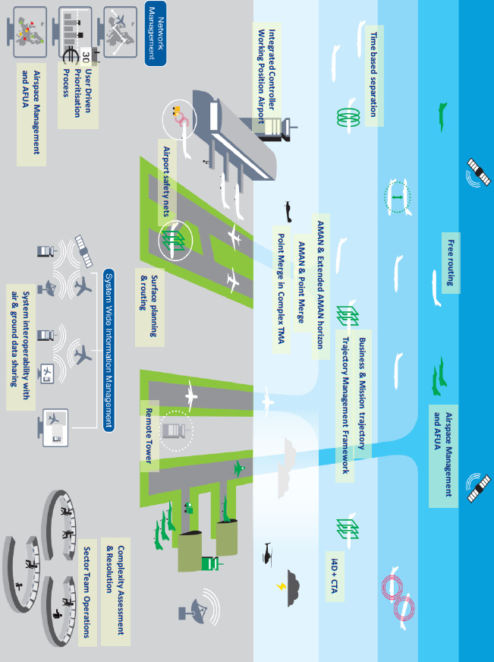



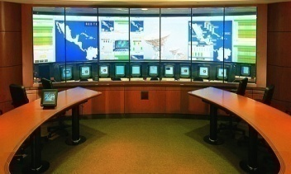





The GAMMA Concept
ATM Nodes
Local Security
Systems
Systems
Capabilities
Coordination
& Control
LGSOC
LGSOC
Cyber Security
intelligence
NGSMP
EGCC
LGSOC
Attack
Prediction
Local
National
European

Slide 18


The GAMMA Concept
Two different human roles are considered within the GAMMA concept:
  GAMMA Operators, represented by actors performing functions within the LGSOC, NGSMP and EGCC
  GAMMA Users, represented by Users of the local security systems.
GAMMA User
GAMMA
Operator
GAMMA
Operator
GAMMA
Operator
ATM Nodes
Local Security
Systems
ecurity
Systems
Capabilities
Coordination
& Control
LGSOC
LGSOC
Cyber Security
intelligence
NGSMP
EGCC
LGSOC
Attack
Prediction
Local
National
European

Slide 19
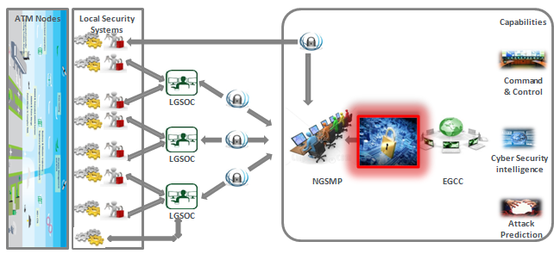
ATM Security Regulatory Framework:
Roles and responsibilities
NATO
EDA
ICAO
NETWORK MANAGER
EACCC
ECAC
CAA
EC
Airspace Users
NGA
… others
ANSP
EASA
GAMMA
Operator
ANSP
GAMMA
Operator
GAMMA
Operator

Slide 20
The GAMMA Concept: Local level
The GAMMA solution is designed for seamless adaption and integration into the local ATM systems. For this reason the local level is represented by two types of solutions:
  Local security systems embedded in the current or future ATM systems (and/or procedures) that address security aspects operating independently.
  A specific GAMMA system (LGSOC) with access to the information defined within GAMMA to support the local security activities.
ATM Nodes
Local Security
Systems
ecurity
Systems
Capabilities
Coordination
& Control
LGSOC
LGSOC
Cyber Security
intelligence
NGSMP
EGCC
LGSOC
Attack
Prediction
Local
National
European

Slide 21
The GAMMA Concept: National level
The National level will have the capability of processing and analysing the information received from the lower level through the operation of an information sharing platform (NGSMP) allowing the detection and prediction of attacks as well as proposing the corresponding alerts, actions or countermeasures and predicting corresponding impacts.
ATM Nodes
Local Security
Systems
ecurity
Systems
Capabilities
Coordination
& Control
LGSOC
LGSOC
Cyber Security
intelligence
NGSMP
EGCC
LGSOC
Attack
Prediction
Local
National
European

Slide 22
The GAMMA Concept: European level
The European Level (EGCC) will enrich the opportunely sanitized information derived from the National level extending the cooperation platform through the operation of Cyber Intelligence functionalities in order to discover possible external threats related not only to the ATM environment but also to other services/systems whose disruption or destruction could cause domino effect on ATM.
The EGCC will then be responsible for feeding such information to the NGSMP for further dissemination to the local levels.
ATM Nodes
Local Security
Systems
ecurity
Systems
Capabilities
Coordination
& Control
LGSOC
LGSOC
Cyber Security
intelligence
NGSMP
EGCC
LGSOC
Attack
Prediction
Local
National
European

Slide 23

The GAMMA Concept: The need for Sanitisation
Sanitisation of information to be disseminated to European level should be seen as a prerequisite for the successful exploitation of collaborative environments within the existing regulatory framework.
Sanitisation of the information aims to categorize the sensitive information, generated at local and national level that can be disseminated at European level, if necessary opportunely modified so as to eliminate sensitive aspects. In the picture below the padlock symbol represents where the sanitization process can be performed.
ATM Nodes
Local Security
Systems
ecurity
Systems
Capabilities
LGSOC
Coordination
& Control
LGSOC
Cyber Security
intelligence
NGSMP
EGCC
LGSOC
Attack
Prediction
Local
National
European

Slide 24

GAMMA Concept and Vision
The GAMMA concept therefore opens the way for the European level to propose (but not enforce) recommendations on actions or measures to be taken at lower levels, in line with existing principles of national sovereignty and responsibilities over security issues.
The GAMMA architectural vision therefore enlarges the scope for cooperative management of ATM security while remaining rooted in the fundamental principle that Security cannot be outsourced or delegated.

Slide 25
Instantiation of concept in prototypes

Slide 26
Security Threats in the ATM world
Jamming
Malicious media
injection
Small RPA used as a weapon
Network DDoS attack
Non authorized personnel attack
Compromise the use of RPAS Ground Station infrastructure
Network attack
False ATCO
Runway incursion
Swim SQL Injection

Slide 27








GAMMA Prototypes
Satcom Security
Integrated
Modular
Communication
Cybersecurity
Intelligent
Platform
Secure
GNSS
communications
Coordination
and Control
System
Secure ATC
communications
Attack
Prediction
Information Dissemination System
Information
Security System
Information
Exchange
Gateway

Slide 28

GAMMA prototypes
Information
Exchange
Gateway
ATM Security
Management Platform
Secure
GNSS
communications
Coordination
and Control
System
Information
Security
System
Secure ATC
communications
Cybersecurity
Intelligent
Platform
© GAMMA.All rights reserved
Attack
Prediction
Information Dissemination System
Integrated
Modular
Communication
Satcom Security

Slide 29
Security Management Platform (SMP)
The role of SMP inside GAMMA solution
The GAMMA Concept has been defined having in mind principles and concepts related to Security Management in a collaborative multi stakeholder environment
The GAMMA vision recognises the opportunities opened by a collaborative framework for managing security, building a solution based on the self-protection and resilience of the ATM system
    SMP is the “core” of GAMMA concept, and will provide a basis for the management of security throughout the phases, from prevention to the identification of security incidents and the efficient resolution of the resulting ATM crises.

Slide 30
Security Management Platform: main functions
  Coordination & Control System:
    Provides Alarm Correlation, Security Monitoring and Decision Support for Incident/Crisis Management
  Attack effect prediction:
    Provides prediction for the adversary actions and possible (expected) impact based on the information received from the SMP.
  Cyber Security Intelligence Platform:
    provide information regarding emerging threats to ATM security, Social and Political contingencies with a possible impact on ATM security.
  Information Dissemination System:
    Disseminate automatically security reports from the SMP at European level to connected SMPs at National levels, applying (automatic) filtering conditions
    Allow the SMP operator at National level to disseminate manually security reports to other connected Security Management Platforms at national or European level
    Show security reports on both tabular and geographical presentations and security critical subjects (e.g. aircraft, network trunk/nodes, critical infrastructures) on the concise situational awareness display allowing for early detection of potential causality/escalation.

Slide 31

Security Management Platform architectural lay out
Command and Control Module
Alerts in input to SMP
Data Collectors
Event Bus
Visualization Module
<Local ATM domain>
<ATM Alarms>
Correlation Engine
Rule Engine
<Local Security Operation Centre>
SECURITY PROTOTYPES:
Information Exchange Gateway
SATCOM Security
Information Security System
Secure GNSS communication
Integrated Modular Radio
Secure ATC communication
<Alarms>
<Alarms>
Decision Support
<Countermeasures>
IDS
Module
Attack Prediction
Module
Cyber Security
Intelligence Platform

Slide 32
The role of SMP in the GAMMA solution
The SMP plays a central role in the GAMMA concept
The GAMMA concept can be conceptualised as a network of distributed nodes embedded within the ATM system and providing interfaces to (ATM) internal and external security stakeholders.
GAMMA establishes three different levels for managing security:
  the European level represented by the European GAMMA Coordination Centre (EGCC),
  the National level represented by the National GAMMA Security Management Platform (NGSMP)
  the Local level represented by local security systems as well as Local GAMMA Security Operation Centers (LGSOC).
The SMP will have:
  One instance at European Level in the European GAMMA Coordination Centre (EGCC)
  One instance for each Nation (NGSMP)

Slide 33
The SMP in the multilayer approach of GAMMA solution
European GAMMA Control Center (EGCC)
Security Management Platform
Command and Control module
Cyber Security
Intelligence Platform
Attack
Prediction
Event Bus
IDS
EUROPEAN LEVEL
NATIONAL
LEVEL
<Cooperation>
<Cooperation>
<Cooperation>
National GAMMA
Security Management Platform
National GAMMA
Security Management Platform
National GAMMA
Security Management Platform
Event Bus
Attack
Prediction
Event Bus
Attack
Prediction
Event Bus
Attack
Prediction
Command and Control
Module
Security
Intelligence
IDS
Command and Control
Module
Security
Intelligence
IDS
Command and Control
Module
Security
Intelligence
IDS
NATION XX
NATION YY
NATION XX

Slide 34
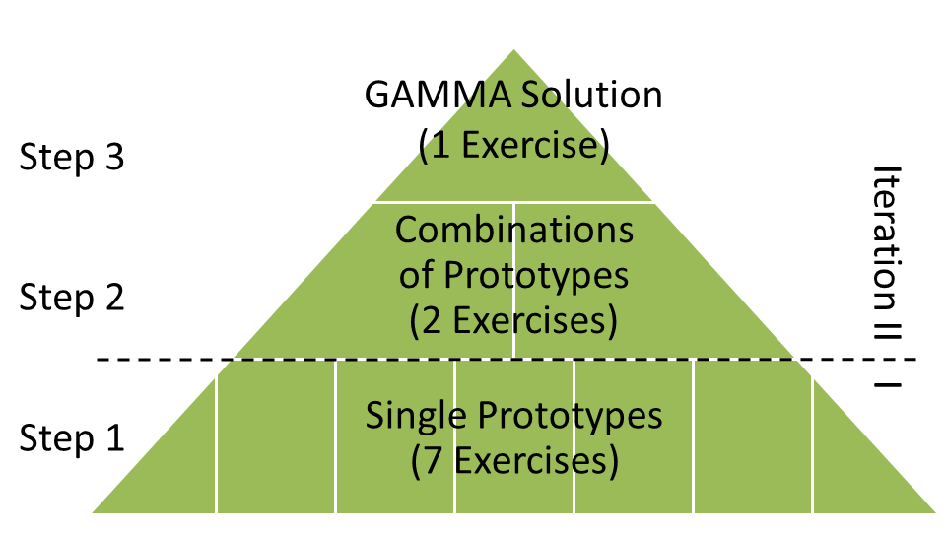
Validation Strategy
Validation follows ATM-security-incidents-centered approach
(not prototype-driven approach)
→ validation scenarios are specified for the selected threats identified in WP2
Most important objective of validation exercises:
demonstrate improvement in security management when security incidents occur
Information regarding GAMMA operational concepts’ feasibility and benefits of GAMMA will be obtained on threat scenario level and for collective validation (summed over all validation exercises).
Validations will be conducted in three steps:
  Single prototype validation
  Validation of combination of prototypes (partially integrated GAMMA architecture)
  GAMMA concept validation (fully integrated GAMMA architecture)

Slide 35

And then …

