Slide 1
A New Vision for ATM Security Management
GAMMA Final Event - Rome, 15 November 2017

Slide 2
























Consortium Composition
Worth over fourteen million euros, GAMMA is co-financed by the European Commission within the Seventh Framework Programme (FP7).
8 Countries
19 partners:
Airbus SAS
Airbus Defence and Space
Airbus Group Innovations
10 Large Industries
3 SMEs
3 Research org. and Universities
3 End-users
Airbus Cybersecurity
Thales UK
Thales Avionics

Slide 3
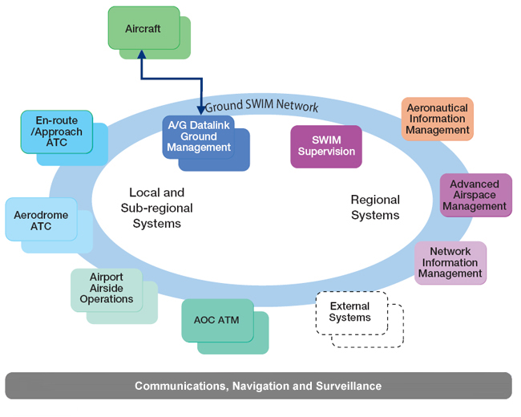
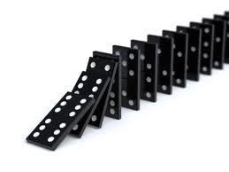
System of systems approach
The GAMMA Project stems from the growing need to address new air traffic management threats and vulnerabilities due, for instance, to increased reliance on automation and interconnectivity between systems. The goal of GAMMA is to develop solutions to these emerging vulnerabilities backed up by practical proposals for their implementation.

Slide 4
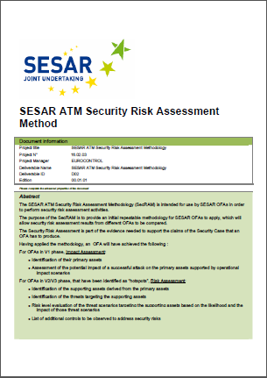
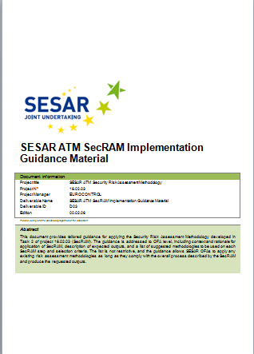
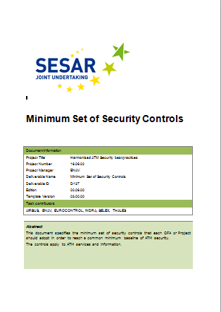
GAMMA: a Helicopter view
Implementation
Proposals
Validation
Validation Platforms
ATM Security Solution
Security Risk Assessment
ATM physical infrastructure Security
ATM CNS Security
ATM Crisis Management
ATM Cyber Security
GAMMA Solution Definition
GAMMA Solution Architecture
(NAF Views)
ATM Security Requirements
ATM Threat Assessment
SESAR
Notes:
4

Slide 5



Security Risk Assessment and Treatment in GAMMA
ATM Core Functions (Primary Assets)
13
SecRAM
What
Supporting Assets
59
Threat Scenarios
(most feared threats)
44
Why
High level Risks
95
Security Controls
318
Security KPIs
How
27

Slide 6
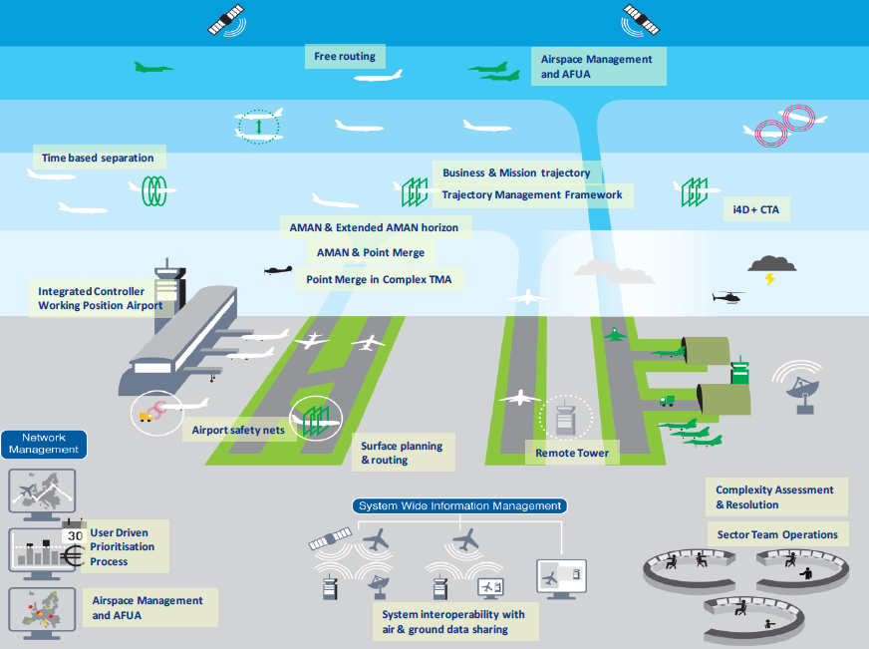







GAMMA prototypes and validation environment
Information
Exchange
Gateway
ATM Security
Management Platform
Secure
GNSS
communications
Coordination
and Control
System
Information
Security
System
Secure ATC
communications
Cybersecurity
Intelligent
Platform
© GAMMA.All rights reserved
Attack
Prediction
Information Dissemination System
Integrated
Modular
Communication
Satcom Security
Validation Environment

Slide 7



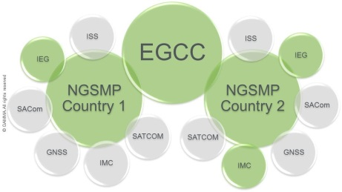
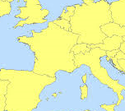
Integrated validation scenarios and deployment
Coordinated attack
Non coordinated attack
Coordinated
+
Non coordinated attack
Research context
Validation Scenarios
storyboard
…and they all lived happily
…and they all lived happily
…and they all lived happily
Once upon
a time…
Once upon
a time…
Once upon
a time…
IEG
ISS
IEG
ISS
Prototype and
Validation Environment
preparation
SMP
SMP
SACom
SATCOM
SACom
SATCOM
GNSS
IMC
GNSS
IMC
TRT
IMC
42 Sol
DLR
Airbus
DS
Airbus
Cyber
Geo-distributed
Deployment
LEONARDO
TASE
LEONARDO
BRTE
LEONARDO

Slide 8
A New Vision for ATM Security Management
GAMMA Final Event - Rome, 15 November 2017

Slide 9

ATM Security Risk Assessment and
GAMMA
Tim H. Stelkens-Kobsch, DLR
adapted from Rainer Koelle
GAMMA Final Event - Rome, 15 November 2017

Slide 10
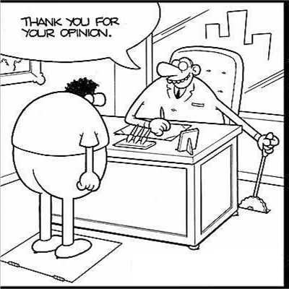
The Security Problem
Security is a thousand year old discipline;
… every year there is a new lessons learnt, new research, new technologies, new techniques, new products, and even new laws
… and every year things get worse.
(adapted from Bruce Schneier)
If left untouched,
… Security Levels will degrade over time

Slide 11
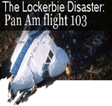


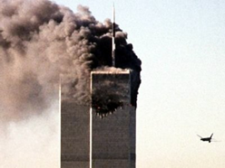

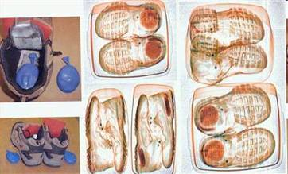

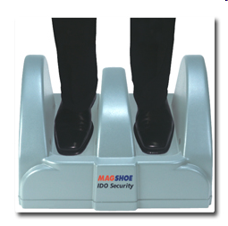
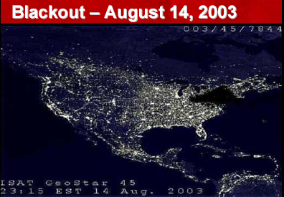

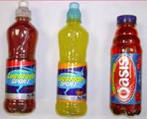



Defining Moments
Defining Moments
1988
2001
2001
20xx
2005
2006
2009
2006
20xx
2006
2009
“underpants bomber”

Slide 12
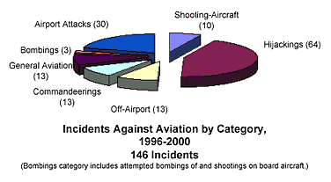
Changing Face of Aviation Security
1948
flight from persecution or prosecution
1968
political phase
1994
aircraft destruction
2001
<<< post - 9/11 >>>
aircraft as weapon ?
Taken from ICAO AVSEC Seminar 2005, Marrakech;
presentation by Canadian Air Transport Authority, Mark Duncan, Executive Vice President
today
<<<15 years post - 9/11 >>>
“cyber”

Slide 13
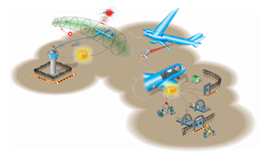
Airport Security
Safeguarding of the airport
Aircraft Security
Safeguarding of the aircraft
Airspace Security
Safeguarding of the airspace
ATM Security
Safeguarding of the ATM System
Collaborative support to national / Pan European aviation
security incident management

Slide 14
Why GAMMA?
New Vulnerabilities
While SESAR improves performance and dependability of ATM, it opens the way to new vulnerabilities due, for instance, to:
  increased reliance on distributed enterprise computing
  automated flow of information across a ground and airborne network
Cyber attacks come from many sources and have a range of possible targets, including civilian, commercial and military systems to damage critical services

Slide 15

The Transition to the New System
ASAS
4D
…
New
Operational
Concepts
Tomorrow’s ATM System
CWP
FDP
RDP
…
More
COTS
Products
Evolution
Today’s
ATM
System
Transition
Open
Standards
More
Inter-
connected
Systems
SWIM
AG
GG
…
More
Data
Sharing
AIM
CIA
provenance
…
TCP/IP
XML
HTML
…

Slide 16
Threats and Vulnerabilities
Threat
… capabilities, intentions, and
attack methods of adversaries to exploit, or any condition, circumstance or event with the potential to cause harm to assets.
Threat is different from threat source!
… sources of threat range from vandals to terrorists (and even states).
Vulnerabilities
… weaknesses of a system or control …
“Social Engineering”
Electro-magnetic space
Cyber space
Natural/physical attack space

Slide 17
Security Risk Management
Security Risk Management
Security Risk Management
“external” aspects
- risk policy
- risk appetite
Risk Assessment
assets
Decision
(Risk Response)
Risk Identification and
Assessment
threats
Security Measures/
Controls
vulnerabilities
mitigation
Risk Monitoring

Slide 18
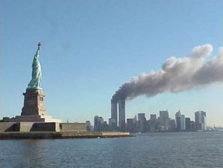



SESAR ATM Security Reference Material
Supporting Documents
SESAR 1
SESAR 2020
EC 2096/2005, CR
EC 1035/2011, CR
Dir 2016/1048, NIS
Doc 8973 AVSec
Doc 9854 ATM Op Concept, 2005
Annex 17 amend. 12, 2011 (ATSP, cyber)
Doc 9985 ATM Sec, 2013 (Secure design)
Doc 30 AVSec, Ed 13, 2010 (Ch 13, ATM Sec)
2001
2009
2016

Slide 19
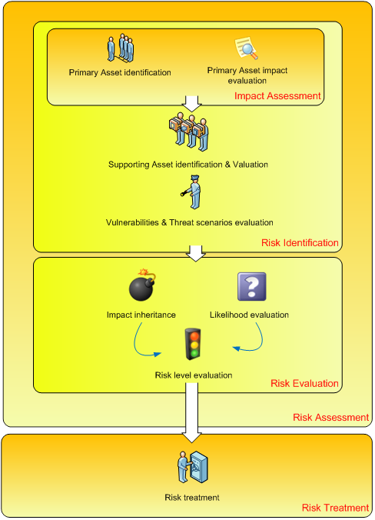
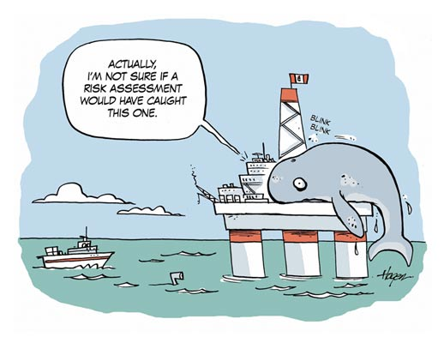
Risk Assessment Methodology
The Security Risk Assessment Methodology
Identify :
Assets
Impacts on CIA
Risks
Controls

Slide 20
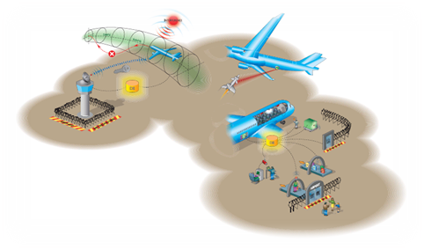
Holistic Approach to Controls
Operation of ICT Systems
Systems isolated
Network security
Backups
Change mgmt
Organisation, Culture & Management
Clear roles & Responsibilities
Risks managed
Technical Mechanisms & Infrastructure
- Access control – networks, OS, applications, user mgmt.
Compliance
- Legal, Policy, Standards
Corporate Direction & Policy
- Policy supported
Tomorrow’s ATM System
Monitoring & Audit
Logging
Audits
Acquisition & Development
IS security
Anti-malware
Physical & Environmental Security
Secure perimeter
Equipment maintenance
…
Human Resources
Training
Vetting
…
If you think technology can solve your security problems, then you don’t understand the problems and you don’t understand the technology. Bruce Schneier

Slide 21
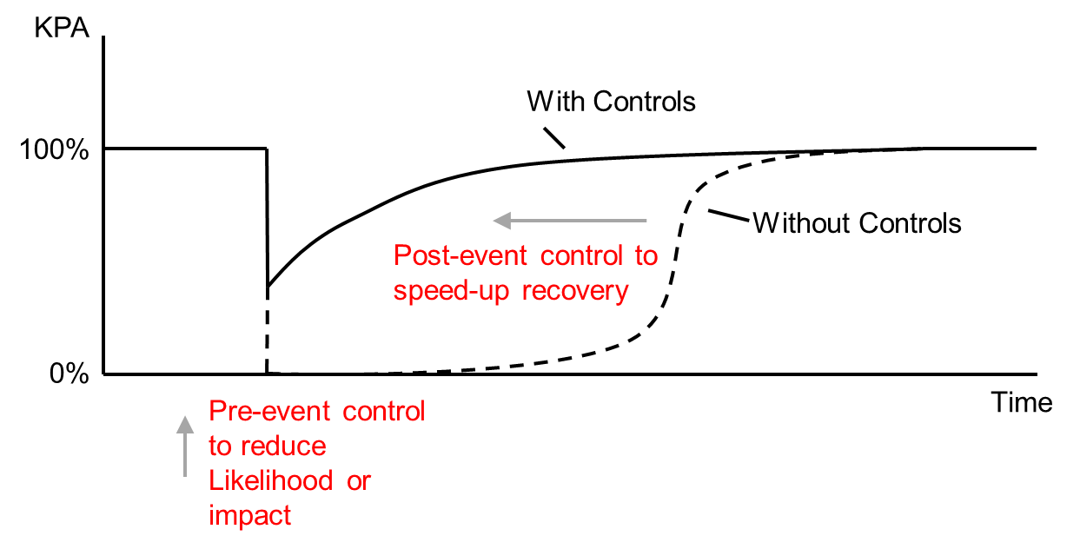
Security Risk Management and Operational Continuity Management
Preventing an incident by protecting the system from an attack
Recovering to normal operations as safely/quickly as possible
This is realised by performing a Security Risk Assessment to identify what needs to be protected and how to protect it and then follow through with operating the security system !

Slide 22

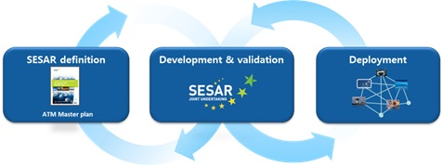
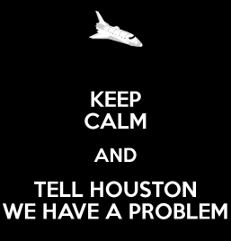
The Overlooked Security Function
SESAR Definition Phase
Budget cuts → redefinition of security working packages
SESAR Development Phase
Security “transversal activity”
Security Risk Assessment
Limited security engineering
SESAR Deployment Phase
“pilot” projects to deliver operational benefits
Deployment Plan “recognises”
“cyber security”

Slide 23
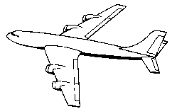
Definition of ATM Security mapped to
ATM/Air Navigation System
air
navigation
airspace
services
user
Air Navigation System
ATM System
“ATM Security Function”
“security
aviation
coordination”
security
services
stakeholder
Notes:
ATM (Air Navigation) System is to ensure the safe, efficient, and orderly flow of air traffic
ATM Security has to ensure (self-protection/resilience) the security of the associated air navigation services to the airspace users.
Management of security requires introduction of “ATM Security Function” within air navigation system. Function is defined as operational, procedural, and technical means to ensure objective.

Slide 24
GAMMA - Security Risk Assessment - Summary
Security is not a fundamentally new problem
Understanding of ATM Security as a component of Aviation Security has matured over the last 15 years
ATM System is undergoing a fundamental transformation (new technologies, new concepts of operations)
While SESAR and NextGen address Security on a transversal system engineering level (i.e. security risk assessment),
the development of security solutions is minimal, and
deployment activities / opportunities are not used
GAMMA addressed this void!
Structured security risk assessment process building on SESAR
Security solution prototype development and targeted validation
Security Function a fundamental enabler for security management

Slide 25



Thank you and follow us @
http://www.gamma-project.eu

