Slide 1
The P1 Validation Exercise

Slide 2
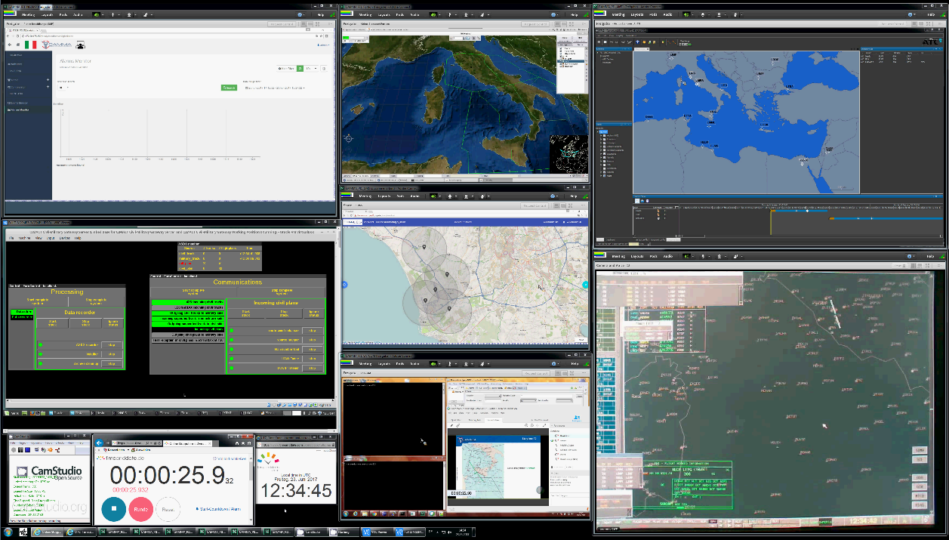
The Geo-Distributed Validation Platform
Fortion®1SkyControl screen
SMP screen
AirTG screen
CIMACT screen
GNSS screen
ATC Controller Position screen
SATCOM
Security
screen

Slide 3
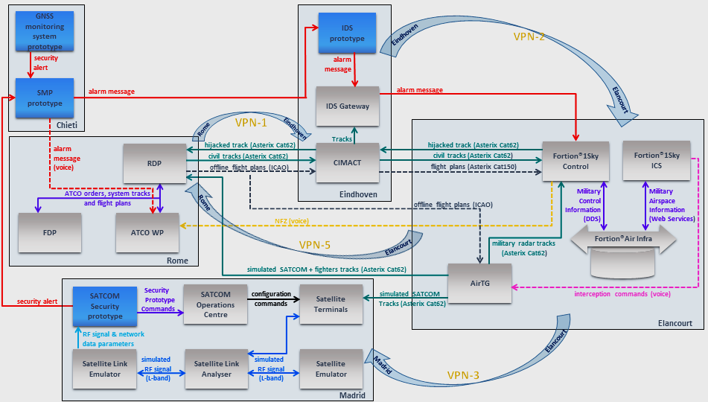
The Total Deployment

Slide 4
GAMMA Prototypes involved in the Partial 1

Slide 5
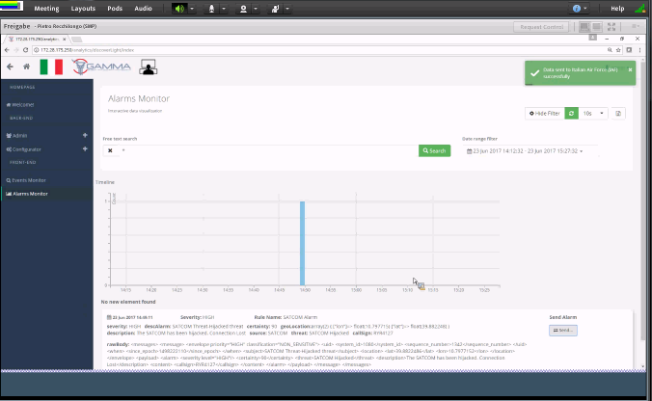
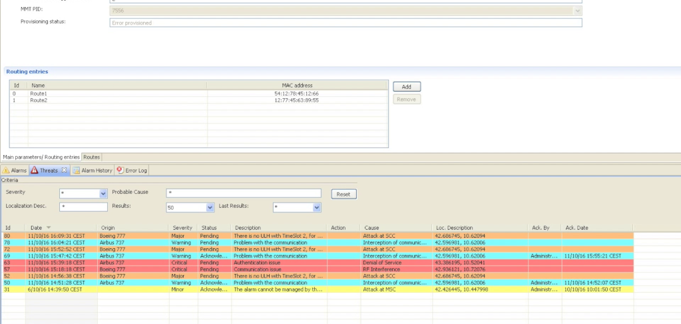
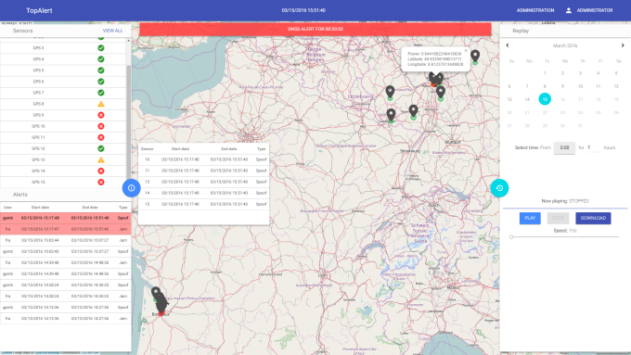
GAMMA Prototypes involved in the Partial 1
SMP prototype
SATCOM prototype
GNSS prototype

Slide 6
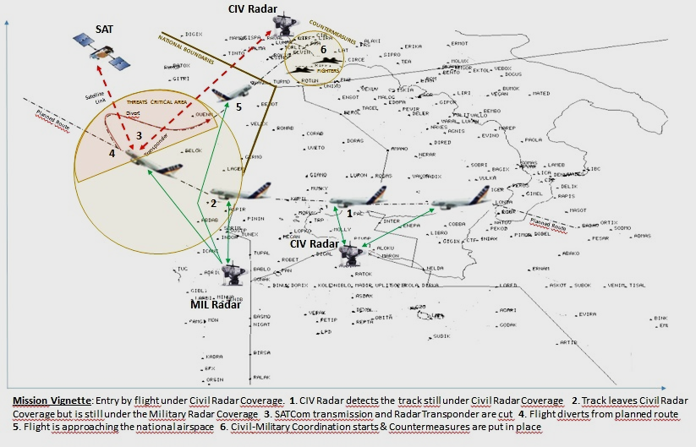
The P1 Validation Scenario
The main objective of the GAMMA P1 Validation Exercise was to give a brief guidance to the demonstration (using two different exercise runs) of the GAMMA security prototypes added value in the sense of “what happens with” and “what happens without” GAMMA (i.e. whether the GAMMA solution is on board or not) during simultaneous attacks on Satellite Communication and Navigation Systems.
Highlights of the Validation Scenario: As shown in Fig.1 the Mission Vignette, there is a suspected flight that could be undergoing a hijack incident as evidenced by threats represented by the closure of both the Satellite transmission and Radar Transponder (3); later on the flight diverts from the planned route (4) and is directed towards the National Airspace (5). As a consequence of these threats, Civil‐Military coordination starts and baseline countermeasures are put in place (6) and:
Fighters are scrambled
NFZ (No‐Fly Zone) is established
Surrounding traffic is rerouted
The Non-Coordinated Attacks : the Storyline is enriched with a simultaneous jamming threat detected at Roma Leonardo Da Vinci airport: a mobile personal privacy device (PPD) jammer comes across the airport and disturbs the traffic in the area and:
As a result of the threat assessment, an alarm will be generated
The GAMMA operator identifies both attacks (the hijacking attack inside the aircraft and the jamming at the airport) as non-coordinated attacks.
Fig. 1 The Mission Vignette

Slide 7
The P1 Validation Scenario

Slide 8
Added Value of the GAMMA concept in the P1 excercise
The added value of the GAMMA Concept was to demonstrate how the Security Prototypes represent the intelligence for a very fast detection of these threats which, in this case, are represented by the “intentional” cut of the Satellite transmission and by an unpredictable behaviour of the flight that could threaten the national security. In a nutshell:
the fast dissemination of an alarm to the Military authority together with a trusted and secure information will permit to speed up and improve all countermeasures in order to intercept the flight before it leaves the critical area and violates the national boundaries.
the added value of the GAMMA concept resides in the ability to optimize the military intervention time and, as a consequence, to make fighters able to intercept the suspected flight on the basis of clear information concerning the threat and not in the proximity of the national boundaries but inside the critical area where the threats first emerge.
the info that the Satellite transmission is cut intentionally (by SATCom prototype) together with the info that there is a jamming threat at the airport (by GNSS prototype) and, consequently, the fact that the corresponding Military and Security agencies are informed earlier of pre‐identified issues (by SMP prototype), can be considered both the improvement of the baseline countermeasures and the added value of GAMMA against the baseline itself.

Slide 9
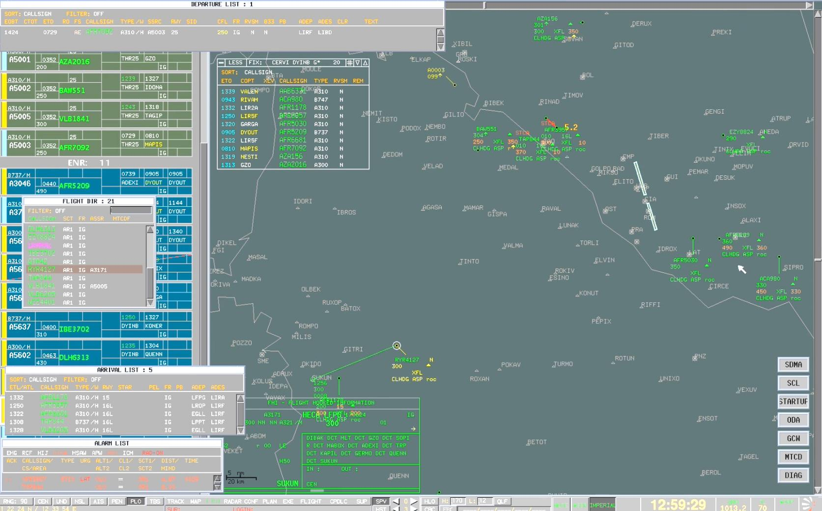
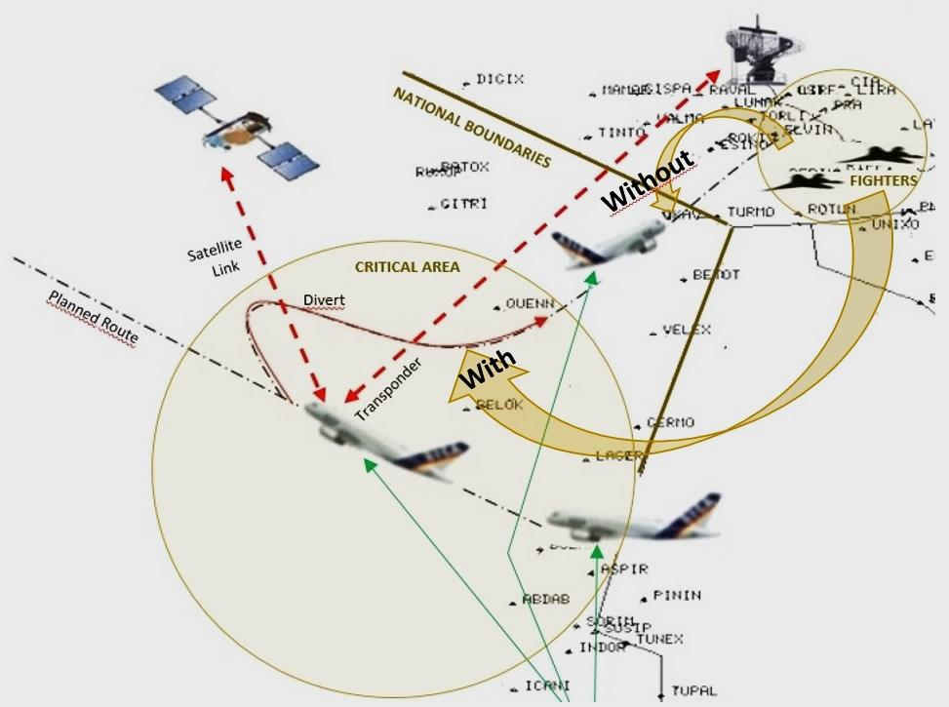
The P1 Validation Scenario
The main objectives of the Partial 1 Validation Exercise were to demonstrate:
what happens with the GAMMA solution on board during simultaneous attacks on Satellite Communication and Navigation System
how a very fast detection of Security threats, which in this case are represented by the “intentional” cut of the Satellite transmission and by an unpredictable behaviour of the flight that could threaten the national security, could be enabled by the GAMMA prototypes intelligence

Slide 10
WITH & WITHOUT GAMMA: THE MEASUREMENTS
Measurements of the exercise run “with” GAMMA and “without” GAMMA were executed…

Slide 11
WITH & WITHOUT GAMMA: THE MEASUREMENTS
Measurements of the exercise run “with” GAMMA and “without” GAMMA revealed the following results:
Recorded time until reaction:
Baseline version (without GAMMA): 11’55”
Version with GAMMA: 8’00”
Measured improvement of GAMMA: 3’55”
Recorded time until mitigation:
Baseline version (without GAMMA): 22’21”
Version with GAMMA: 16’23”
Measured improvement of GAMMA: 5’58”

Slide 12
SEE YOU THIS AFTERNOON FOR THE DEMO ☺

